Slide 1
Graph Representations
Adjacency Matrix & Adjacency List
Editable Java code + classroom-ready visualizations
1
2
Unweighted
Weighted
Directed
Undirected
5
0
4
2
Lesson focus
1. Store graph connections in a 2D matrix
2. Store graph connections in linked adjacency lists
3. Change only the edge insertion rule for each graph type
1
3
3
6
4

Slide 2
Graph Types in This Lesson
The same graph idea changes based on direction and weight.
Unweighted + Undirected
Unweighted + Directed
Store 1 in both directions: A[u][v] = 1 and A[v][u] = 1
Store 1 only from source to destination: A[u][v] = 1
Weighted + Directed
Weighted + Undirected
Store the edge weight only in A[u][v]
Store the edge weight in both A[u][v] and A[v][u]
Key idea
Only the addEdges() logic changes; printing and neighbor scanning are almost the same.

Slide 3
Adjacency Matrix: Core Idea
A V x V matrix stores whether an edge exists between vertices.
0
1
2
3
4
Undirected
Directed
0
0
1
0
1
0
A[u][v] and A[v][u]
are both updated.
Only A[u][v] is updated.
A[v][u] may remain 0.
1
1
0
1
1
1
2
0
1
0
0
1
3
1
1
0
0
1
Unweighted
Weighted
Use 1 to show a connection.
Use the edge weight instead of 1.
4
0
1
1
1
0
Matrix rule
Row 1, column 4 = 1 means vertex 1 is connected to vertex 4.
Row = source vertex
Column = destination / neighbor
0 = no edge

Slide 4
Adjacency Matrix: Undirected Unweighted Graph
Example from the driver: edges are added in both directions.
Graph
Adjacency Matrix
0
1
2
3
4
1
0
0
1
0
1
0
1
1
0
1
1
1
0
2
2
0
1
0
0
1
3
1
1
0
0
1
4
0
1
1
1
0
3
4
Observation
The matrix is symmetric.
For every 1 in A[u][v], there is a matching 1 in A[v][u].

Slide 5
Editable Java: Undirected Unweighted Matrix
Core class code is editable.
public class GraphUndirectedUnweightedMatrix {
private int numVertices;
private int[][] adjMatrix;
public GraphUndirectedUnweightedMatrix(int numVertices) {
this.numVertices = numVertices;
adjMatrix = new int[numVertices][numVertices];
}
public void addEdges(int[][] edges) {
for (int i = 0; i < edges.length; i++) {
int source = edges[i][0];
int destination = edges[i][1];
adjMatrix[source][destination] = 1;
adjMatrix[destination][source] = 1;
}
}
public void printMatrix() {
System.out.println("Adjacency Matrix:");
for (int i = 0; i < numVertices; i++) {
for (int j = 0; j < numVertices; j++)
System.out.print(adjMatrix[i][j] + " ");
System.out.println();
}
}
public void findNeighbors(int vertex) {
System.out.print("Neighbors of vertex " + vertex + ": ");
for (int i = 0; i < numVertices; i++)
if (adjMatrix[vertex][i] == 1) System.out.print(i + " ");
System.out.println();
}
}
Insertion rule
Because the graph is undirected, one edge creates two matrix updates.
int[][] edges = {
{0,1}, {0,3},
{1,3}, {1,2}, {1,4},
{2,4},
{3,4}
};
GraphUndirectedUnweightedMatrix graph =
new GraphUndirectedUnweightedMatrix(5);
graph.addEdges(edges);
Result
The final matrix has 1s in symmetric positions.

Slide 6
Adjacency Matrix: Directed Unweighted Graph
Some pairs are bidirectional, while some edges are one-way.
Graph
Adjacency Matrix
0
1
2
3
4
1
0
0
1
1
0
0
1
1
0
1
1
0
0
2
2
0
1
0
0
0
3
0
0
1
0
1
4
1
0
1
0
0
3
4
Observation
The matrix is not symmetric.
Example: A[4][0] = 1 but A[0][4] = 0.

Slide 7
Editable Java: Directed Unweighted Matrix
Only source -> destination is stored.
public class GraphDirectedUnweightedMatrix {
private int numVertices;
private int[][] adjMatrix;
public GraphDirectedUnweightedMatrix(int numVertices) {
this.numVertices = numVertices;
adjMatrix = new int[numVertices][numVertices];
}
public void addEdges(int[][] edges) {
for (int i = 0; i < edges.length; i++) {
int source = edges[i][0];
int destination = edges[i][1];
adjMatrix[source][destination] = 1;
}
}
public void printMatrix() {
System.out.println("Adjacency Matrix:");
for (int i = 0; i < numVertices; i++) {
for (int j = 0; j < numVertices; j++)
System.out.print(adjMatrix[i][j] + " ");
System.out.println();
}
}
public void findNeighbors(int vertex) {
System.out.print("Neighbors of vertex " + vertex + ": ");
for (int i = 0; i < numVertices; i++)
if (adjMatrix[vertex][i] == 1) System.out.print(i + " ");
System.out.println();
}
}
Insertion rule
Do not automatically add the reverse edge.
int[][] edges = {
{0,1}, {0,2},
{1,0}, {1,2}, {1,3},
{2,1},
{3,2}, {3,4},
{4,0}, {4,2}
};
Neighbor meaning
Neighbors of u = vertices reachable from row u.

Slide 8
Adjacency Matrix: Directed Weighted Graph
Nonzero values store edge weights, not just 1.
Graph
Adjacency Matrix
0
1
2
3
4
4
0
0
2
3
0
0
5
1
1
0
0
0
4
5
2
0
4
2
0
0
0
6
0
3
3
3
0
0
0
0
0
6
2
4
0
0
0
0
0
Observation
A[1][3] = 4 means there is a directed edge 1 -> 3 with weight 4.

Slide 9
Editable Java: Directed Weighted Matrix
The edge format is {source, destination, weight}.
public class GraphDirectedWeightedMatrix {
private int numVertices;
private int[][] adjMatrix;
public GraphDirectedWeightedMatrix(int numVertices) {
this.numVertices = numVertices;
adjMatrix = new int[numVertices][numVertices];
}
public void addEdges(int[][] edges) {
for (int i = 0; i < edges.length; i++) {
int source = edges[i][0];
int destination = edges[i][1];
int weight = edges[i][2];
adjMatrix[source][destination] = weight;
}
}
public void printMatrix() {
System.out.println("Adjacency Matrix:");
for (int i = 0; i < numVertices; i++) {
for (int j = 0; j < numVertices; j++)
System.out.print(adjMatrix[i][j] + " ");
System.out.println();
}
}
public void findNeighbors(int vertex) {
System.out.print("Neighbors of vertex " + vertex + ": ");
for (int i = 0; i < numVertices; i++)
if (adjMatrix[vertex][i] != 0) System.out.print(i + " ");
System.out.println();
}
}
Insertion rule
Store weight only in A[source][destination].
int[][] edges = {
{0,1,2},
{0,2,3},
{1,3,4},
{1,4,5},
{2,3,6}
};
Neighbor check
Use != 0 because weights may be any nonzero number.

Slide 10
Adjacency Matrix: Undirected Weighted Graph
The same weight is stored in both symmetric positions.
Graph
Adjacency Matrix
0
1
2
3
4
4
0
0
2
3
0
0
5
1
1
2
0
0
4
5
2
0
4
2
3
0
0
6
0
3
3
3
0
4
6
0
0
6
2
4
0
5
0
0
0
Observation
A[2][3] = 6 and A[3][2] = 6. The matrix is symmetric.

Slide 11
Editable Java: Undirected Weighted Matrix
One weighted edge updates two cells.
public class GraphUndirectedWeightedMatrix {
private int numVertices;
private int[][] adjMatrix;
public GraphUndirectedWeightedMatrix(int numVertices) {
this.numVertices = numVertices;
adjMatrix = new int[numVertices][numVertices];
}
public void addEdges(int[][] edges) {
for (int i = 0; i < edges.length; i++) {
int source = edges[i][0];
int destination = edges[i][1];
int weight = edges[i][2];
adjMatrix[source][destination] = weight;
adjMatrix[destination][source] = weight;
}
}
public void printMatrix() {
System.out.println("Adjacency Matrix:");
for (int i = 0; i < numVertices; i++) {
for (int j = 0; j < numVertices; j++)
System.out.print(adjMatrix[i][j] + " ");
System.out.println();
}
}
public void findNeighbors(int vertex) {
System.out.print("Neighbors of vertex " + vertex + ": ");
for (int i = 0; i < numVertices; i++)
if (adjMatrix[vertex][i] != 0) System.out.print(i + " ");
System.out.println();
}
}
Insertion rule
Set both A[source][destination] and A[destination][source] to weight.
int[][] edges = {
{0,1,2},
{0,2,3},
{1,3,4},
{1,4,5},
{2,3,6}
};
Result
A symmetric weighted matrix.

Slide 12
Adjacency List: Core Idea
Each vertex stores a list of its neighbors instead of a full V x V table.
0
3
1
Why adjacency list?
It stores only existing edges, so it is usually more space-efficient for sparse graphs.
1
4
2
3
0
2
4
1
Neighbor search
3
4
1
0
To find neighbors of vertex u, traverse only list[u].
4
3
2
1
Implementation style
In Java, each row can be a linked list of Node objects.

Slide 13
Adjacency List: Undirected Unweighted Graph
An undirected edge inserts each endpoint into the other endpoint's list.
Graph
Adjacency List
1
0
3
1
1
4
2
3
0
0
2
2
4
1
3
4
1
0
3
4
3
2
1
4
Rule
For edge (u, v): insert v into list[u] and insert u into list[v].

Slide 14
Editable Java: Undirected Unweighted Adjacency List
Linked-list based adjacency list.
class Node {
int vertex;
Node next;
Node(int vertex) { this.vertex = vertex; }
}
public class GraphUndirectedUnweightedList {
private int numVertices;
private Node[] adjList;
public GraphUndirectedUnweightedList(int numVertices) {
this.numVertices = numVertices;
adjList = new Node[numVertices];
}
private void insertAtHead(int source, int destination) {
Node newNode = new Node(destination);
newNode.next = adjList[source];
adjList[source] = newNode;
}
public void addEdges(int[][] edges) {
for (int i = 0; i < edges.length; i++) {
int u = edges[i][0], v = edges[i][1];
insertAtHead(u, v);
insertAtHead(v, u);
}
}
public void printList() {
for (int i = 0; i < numVertices; i++) {
System.out.print(i + ": ");
for (Node temp = adjList[i]; temp != null; temp = temp.next)
System.out.print(temp.vertex + " ");
System.out.println();
}
}
}
Insertion rule
Undirected graph: add two linked-list nodes for one edge.
int[][] edges = {
{0,1}, {0,3},
{1,3}, {1,2}, {1,4},
{2,4}, {3,4}
};
GraphUndirectedUnweightedList graph =
new GraphUndirectedUnweightedList(5);
graph.addEdges(edges);
graph.printList();

Slide 15
Adjacency List: Directed Unweighted Graph
Only outgoing neighbors are stored in each source vertex list.
Graph
Adjacency List
0
3
1
1
1
4
2
0
2
2
3
4
1
3
4
2
4
Rule
For edge (u, v): insert only v into list[u].

Slide 16
Editable Java: Directed Unweighted Adjacency List
One edge inserts one node.
class Node {
int vertex;
Node next;
Node(int vertex) { this.vertex = vertex; }
}
public class GraphDirectedUnweightedList {
private int numVertices;
private Node[] adjList;
public GraphDirectedUnweightedList(int numVertices) {
this.numVertices = numVertices;
adjList = new Node[numVertices];
}
private void insertAtHead(int source, int destination) {
Node newNode = new Node(destination);
newNode.next = adjList[source];
adjList[source] = newNode;
}
public void addEdges(int[][] edges) {
for (int i = 0; i < edges.length; i++) {
int source = edges[i][0];
int destination = edges[i][1];
insertAtHead(source, destination);
}
}
public void findNeighbors(int vertex) {
System.out.print("Neighbors of vertex " + vertex + ": ");
for (Node temp = adjList[vertex]; temp != null; temp = temp.next)
System.out.print(temp.vertex + " ");
System.out.println();
}
}
Insertion rule
Directed graph: add only destination to the source list.
int[][] edges = {
{0,1}, {0,3},
{1,2}, {1,4},
{3,1}, {3,4},
{4,2}
};

Slide 17
Adjacency List: Directed Weighted Graph
Each list node stores both destination and weight.
Graph
Adjacency List with Weights
0
1(2)
3(6)
1
2
1
2(3)
4(5)
0
3
2
4
2
6
5
3
1(4)
4(2)
1
3
4
2(1)
2
4
Rule
For edge (u, v, w): insert node v with weight w into list[u].

Slide 18
Editable Java: Directed Weighted Adjacency List
Node stores destination and edge weight.
class WNode {
int vertex;
int weight;
WNode next;
WNode(int vertex, int weight) {
this.vertex = vertex;
this.weight = weight;
}
}
public class GraphDirectedWeightedList {
private int numVertices;
private WNode[] adjList;
public GraphDirectedWeightedList(int numVertices) {
this.numVertices = numVertices;
adjList = new WNode[numVertices];
}
private void insertAtHead(int source, int destination, int weight) {
WNode newNode = new WNode(destination, weight);
newNode.next = adjList[source];
adjList[source] = newNode;
}
public void addEdges(int[][] edges) {
for (int i = 0; i < edges.length; i++) {
int u = edges[i][0], v = edges[i][1], w = edges[i][2];
insertAtHead(u, v, w);
}
}
public void printList() {
for (int i = 0; i < numVertices; i++) {
System.out.print(i + ": ");
for (WNode temp = adjList[i]; temp != null; temp = temp.next)
System.out.print(temp.vertex + "(" + temp.weight + ") ");
System.out.println();
}
}
}
Insertion rule
Only source list is updated; each node stores destination + weight.
int[][] edges = {
{0,1,2}, {0,3,6},
{1,2,3}, {1,4,5},
{3,1,4}, {3,4,2},
{4,2,1}
};

Slide 19
Matrix vs List: Quick Comparison
Choose representation based on what your algorithm needs.
Feature
Adjacency Matrix
Adjacency List
Space
V x V cells
V lists + existing edges
Check edge u->v
Fast direct lookup
Search list[u]
Find neighbors of u
Scan row u
Traverse list[u]
Sparse graph
Can waste space
Usually efficient
Classroom takeaway
Matrices are simpler for direct edge lookup; lists are more natural for neighbor traversal.

Slide 20
Practice: Directed or Undirected?
Determine the type by checking matrix symmetry.
Matrix A
Matrix B
0
1
2
3
4
0
1
2
3
4
0
0
1
0
1
0
0
0
1
1
0
0
1
1
0
1
1
0
1
1
0
1
1
0
2
0
1
0
1
1
2
1
1
0
0
1
3
1
1
0
0
1
3
0
1
0
0
1
4
0
0
1
1
0
4
0
0
1
1
0
Solution A
Solution B
Directed. It is not symmetric.
Example: A[2][3] = 1 but A[3][2] = 0.
Undirected. It is symmetric.
For every A[i][j], A[j][i] has the same value.

Slide 21
Summary Cheat Sheet
Use the rule that matches the graph type.
Undirected + Unweighted
Matrix
List
A[u][v] = 1; A[v][u] = 1
insert v in list[u]; insert u in list[v]
Directed + Unweighted
Matrix
List
A[u][v] = 1
insert v in list[u]
Directed + Weighted
Matrix
List
A[u][v] = w
insert v(w) in list[u]
Undirected + Weighted
Matrix
List
A[u][v] = w; A[v][u] = w
insert v(w) in list[u]; insert u(w) in list[v]
Final rule
Direction controls whether the reverse edge is added. Weight controls whether the stored value is 1 or the edge weight.

Slide 22
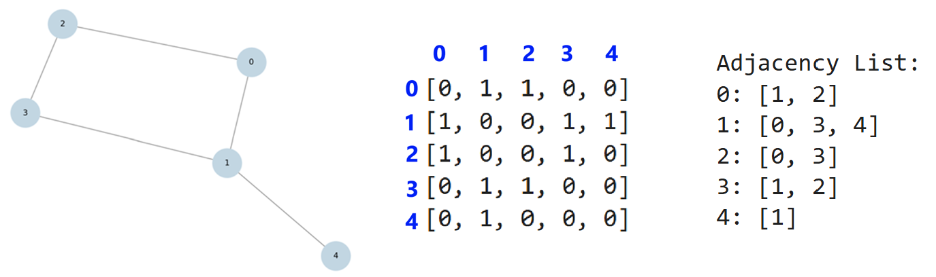
Original PDF Figure: Undirected Unweighted Matrix
Figures inserted directly from the uploaded PDF.

Slide 23
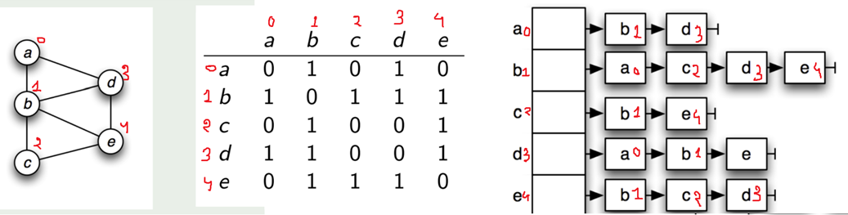
Original PDF Figure: Undirected Matrix + List
Figures inserted directly from the uploaded PDF.

Slide 24
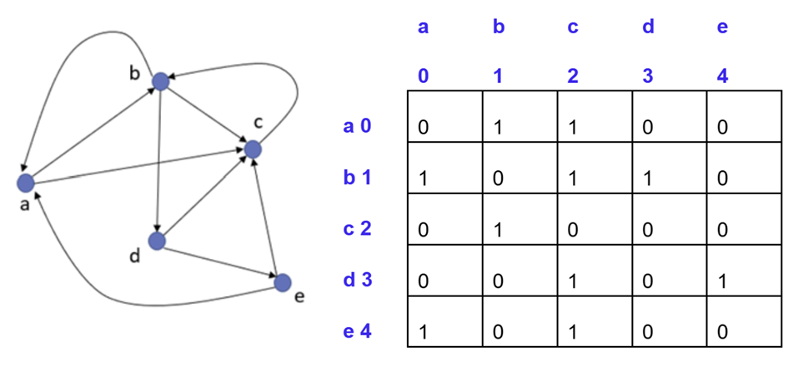
Original PDF Figure: Directed Unweighted Matrix
Figures inserted directly from the uploaded PDF.

Slide 25
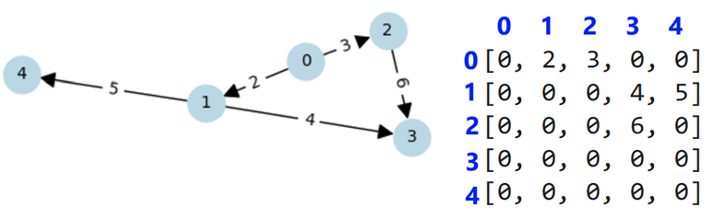
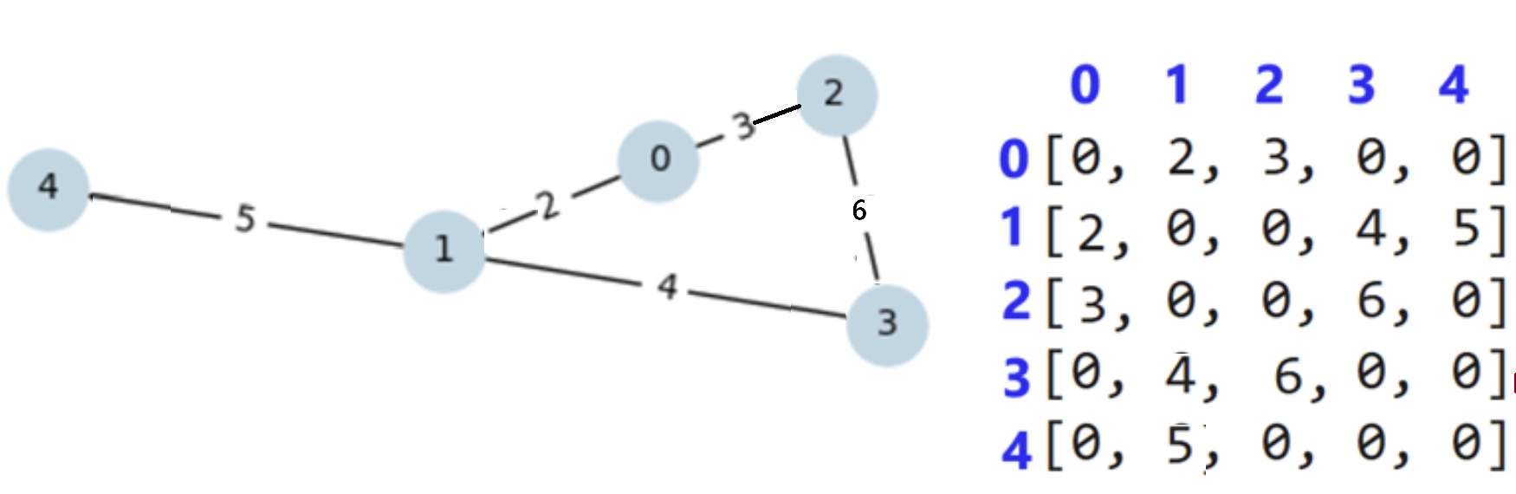
Original PDF Figures: Weighted Matrices
Figures inserted directly from the uploaded PDF.
Directed weighted
Undirected weighted

Slide 26
Original PDF Figure: Undirected Adjacency List
Figures inserted directly from the uploaded PDF.

Slide 27
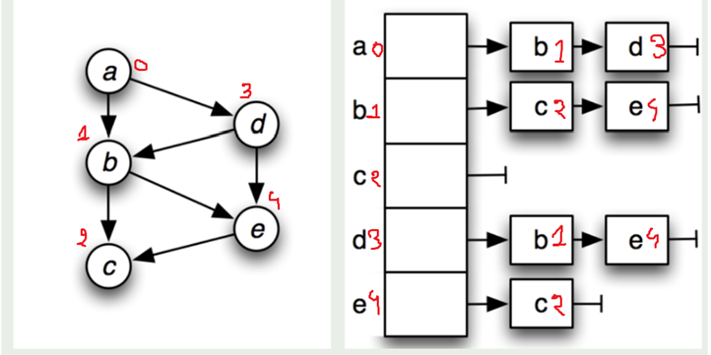
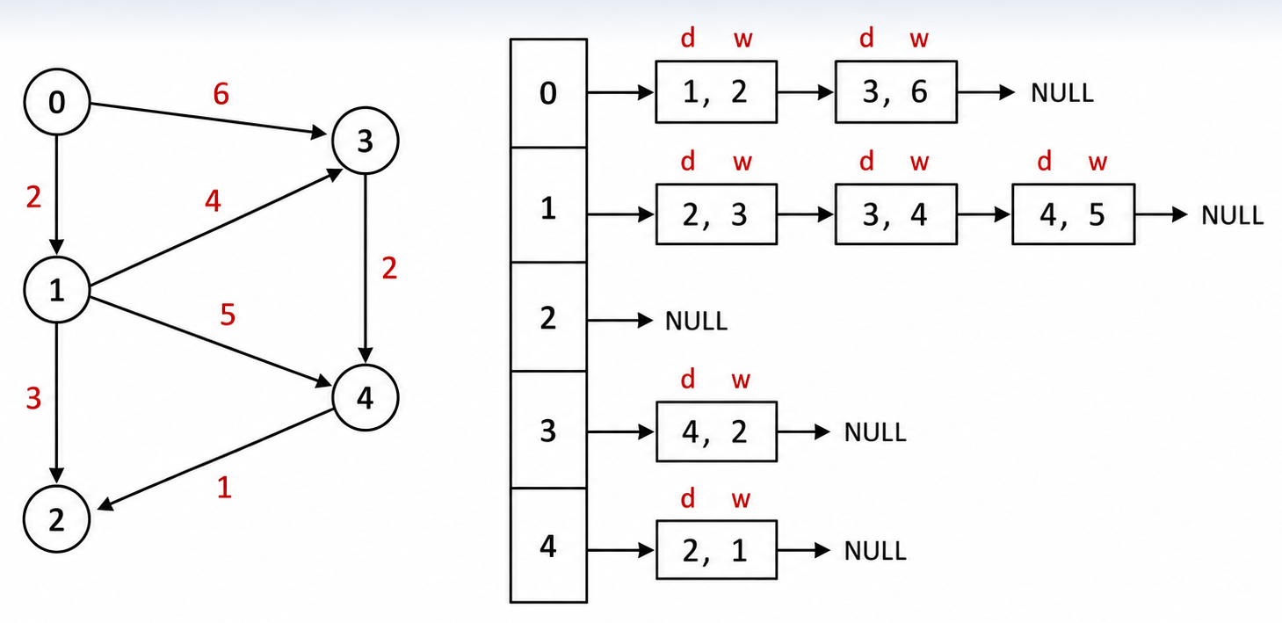
Original PDF Figures: Directed Adjacency Lists
Figures inserted directly from the uploaded PDF.
Directed unweighted list
Directed weighted list

